Slide 1
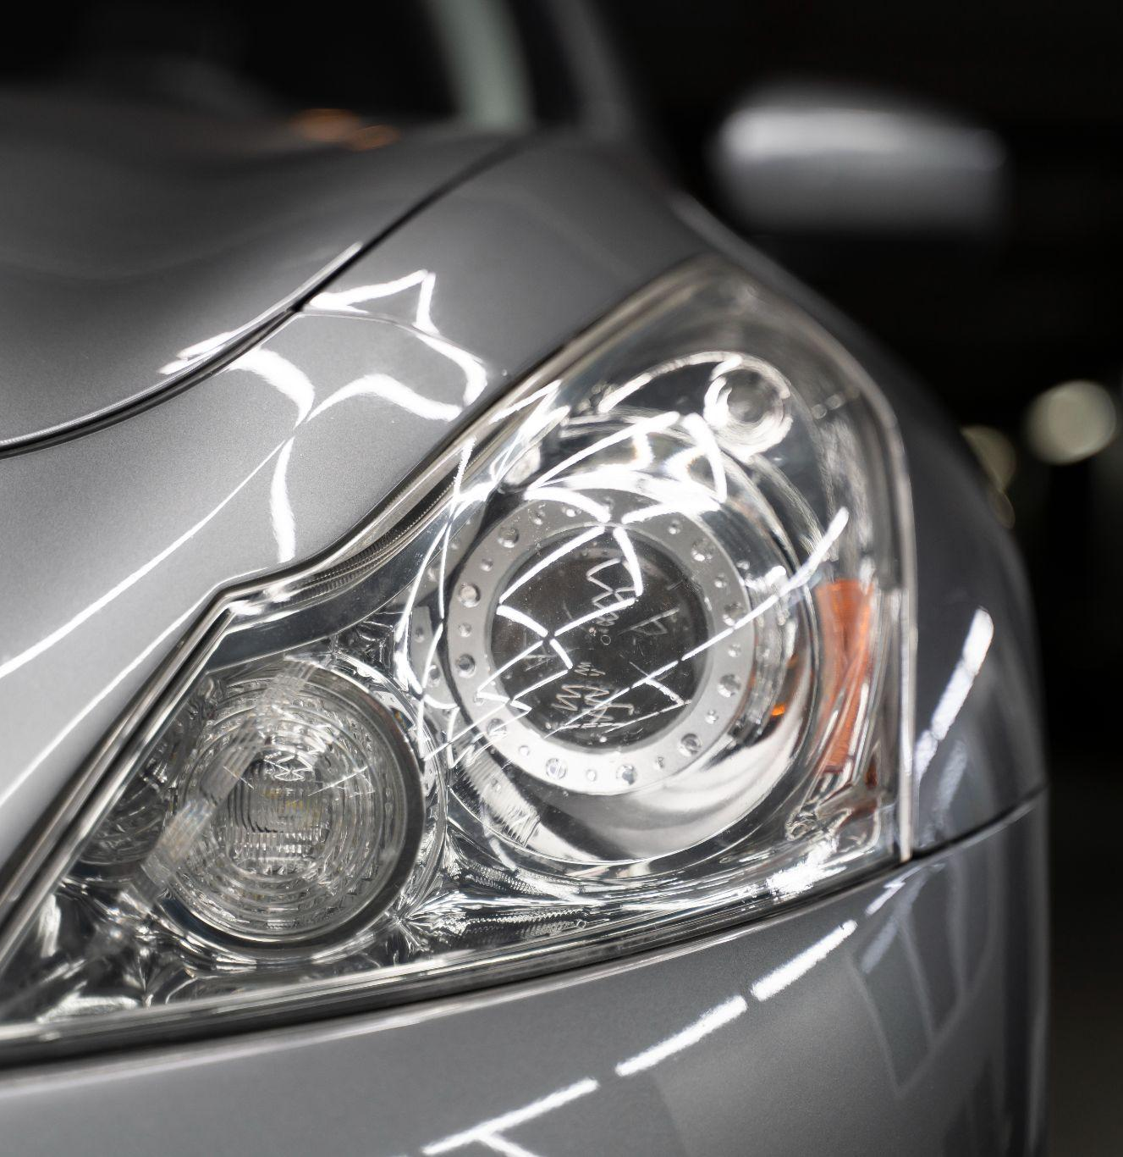
AutoConnect
“
"Driving Your Dreams, One Click at a Time"

Slide 2



Project Supervisor: Mr.Ubaid Aftab Chawala
Ishaqullah Siddiqui
Muhib Ahmed
Sarim Latif Khan

Slide 3

PROBLEM STATEMENT
“
- Complex Car Transactions:
- Choosing the right vehicle
- Negotiating prices
- Assessing vehicle history
- Information Overload:
- Abundance of online car information
- Difficulty in making informed decisions
- Trust Concerns:
- Doubts about trustworthiness of buyers and sellers

Slide 4
SOLUTION OVERVIEW
"Introducing AutoConnect: Transforming the Way You Buy and Sell Vehicles"
- Simplified Decision-Making:
- Intuitive interface
- Streamlines car transactions
- Simplifies choices for users
- Data Intelligence:
- Aggregates and analyzes data
- Provides accurate information
- Includes vehicle history reports and market trends
- Negotiation Assistance:
- Chatbot support
- Offers insights and suggestions
- Helps with fair and beneficial deals
- Trust & Transparency:
- User-generated reviews and ratings
- Enhances trust
- Real-time messaging for transparent communication
- Personalized Recommendations:
- AI recommendation engine
- Suggests vehicles based on user preferences
- Streamlines the search process

Slide 5

LITERATURE REVIEW
- Online Car Marketplaces:
- Essential in the automotive industry
- Facilitating digital transactions
- Leading Platforms:
- PakWheels and CarFirst
- Current Limitations:
- Limited negotiation tools
- Basic communication tools
- Room for Innovation:
- Opportunity to enhance user experience
- Enhance Buyer, Seller communication
- Fueling Negotiations with Smart Middleware

Slide 6
COMPARITVE ANALYSIS
Features | PakWheels | CarFirst | Gaari.pk | AutoConnect
Vehicle Listings | ✓ | ✓ | ✓ | ✓
Selling/Buying Cars | ✓ | ✓ | ✓ | ✓
Vehicle Comparison | ✓ | ✕ | ✓ | ✓
AI Driven Recommendations | ✓ | ✕ | ✕ | ✓
User Reviews | ✓ | ✓ | ✓ | ✓
Customer Support | ✓ | ✓ | ✓ | ✓
Advanced Search Filters | ✓ | ✓ | ✓ | ✓
Live Video Calling | ✕ | ✕ | ✕ | ✓
Smart Negotiation chatbot | ✕ | ✕ | ✕ | ✓

Slide 7
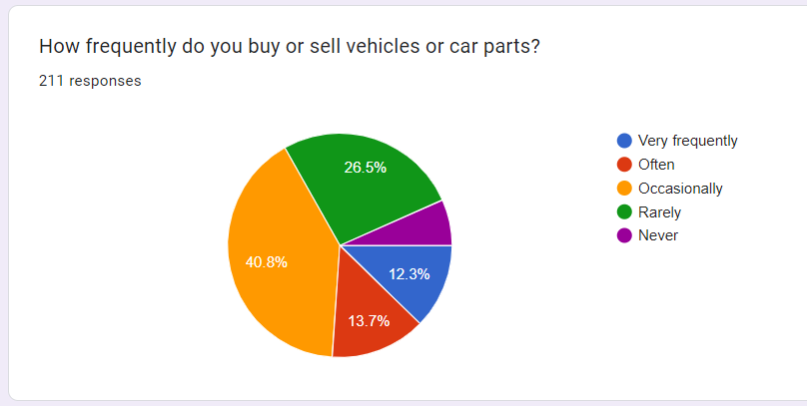
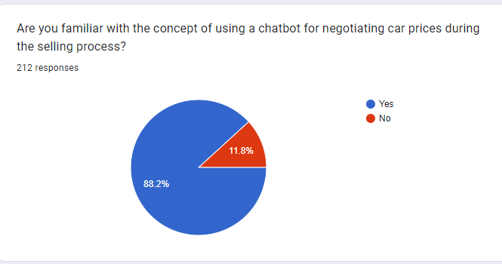
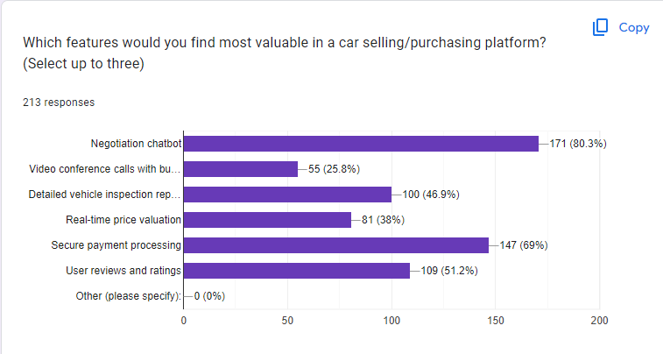
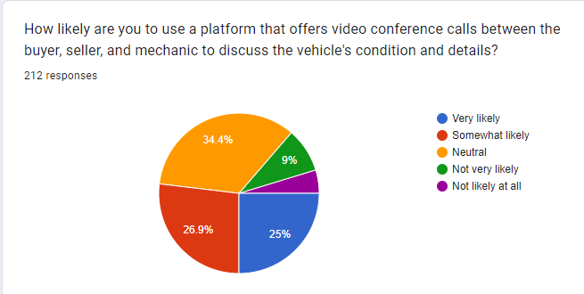
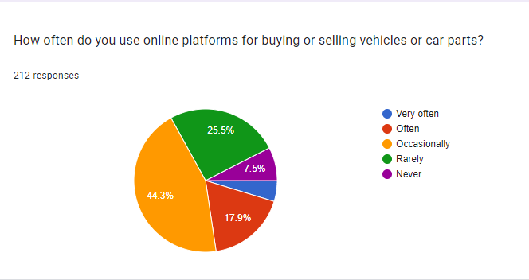
MARKET SURVEY

Slide 8
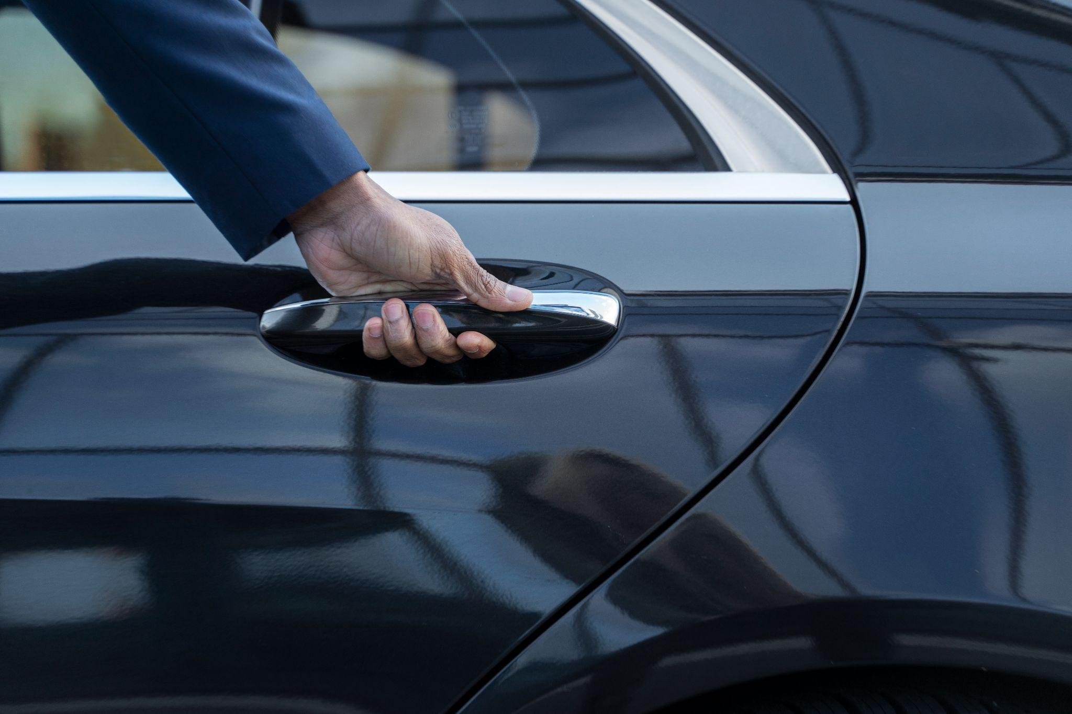
KEY FEATURES
“
1. Smart Negotiation Bot: Say goodbye to haggling. Our bot ensures fair deals.
2. Live Video Calling: Expert-guided vehicle inspections in real-time.
3. Comprehensive Listings: A wide variety of vehicles for every preference.
4. Personalized User Accounts: Tailor your journey.
5. Diverse Portals: Connecting users, mechanics, and enthusiasts.
6. Effortless Vehicle Comparison: Make informed decisions effortlessly.
7. Advanced Search and Filters: Find the exact vehicle you desire.
8. Empowering User Reviews: Contribute to an informed community.
9. Real-time Communication: Swift and effective interactions.
10. Insightful Vehicle History: Access to comprehensive and verified vehicle history.
11. Expert Customer Support: Instant resolution for a smooth experience.
12. AI-Driven Recommendations: Your personalized vehicle suggestions.

Slide 9
BENIFITS
1. Streamlined Car Transactions:
"Say goodbye to the hassle! Our app simplifies car buying and selling, making it as easy as a few clicks."
2. Negotiation Assistance:
"Negotiate like a pro! Our chatbot helps you get the best deal, putting you in the driver's seat."
3. Real-Time Video Calls:
"See it, believe it! Conduct video calls with the seller, buyer, and even a mechanic for complete transparency."
4. Tailored Recommendations:
"Find your dream ride! Our AI learns your preferences and recommends cars that match your style."
5. Extensive Search and Filters:
"Your perfect match is waiting! Use powerful search and filtering options to find the ideal vehicle."

Slide 10
6. User Reviews and Ratings:
"Trust the community! Read user reviews and ratings to make informed decisions."
7. Instant Messaging and Notifications:
"Stay connected! Our real-time messaging and notifications keep you updated on your car journey."
8. Outstanding Customer Support:
- "We've got your back! Enjoy excellent customer support with our live chat and assistance tools."
9. Revolutionize Negotiations:
- "Empower yourself! We're changing the game with AI-powered negotiations."
10. Modern, Intuitive UI:
- "Beauty and brains! Our app combines stunning design with effortless usability."

Slide 11
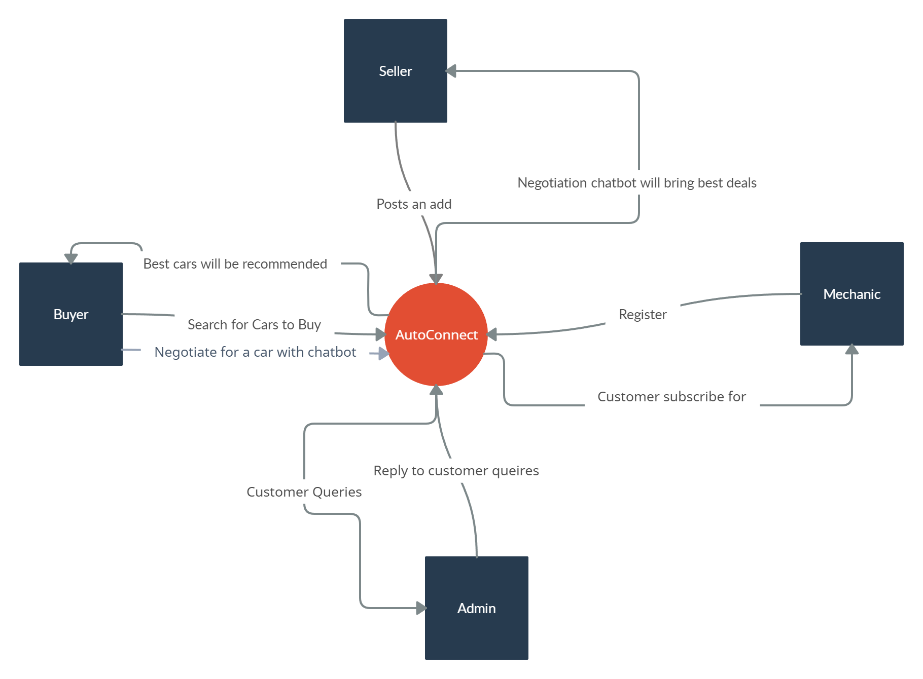
SYSTEM DIAGRAM

Slide 12
TECH STACK
Front End
Back End
Chat bot
-React
-Redux
-MUI
-React Router
-Node JS
-Express
-MongoDB
-Passport.js
-Elastic Search/Algolia
-Socket.IO
-TensorFlow.js/Brain.js
-NLP
-NLTK/Spacy
-ML
-Tensor Flow/PyTorch
-Dialogue Flow
-Dialogue Flow By Google

Slide 13
WATERFALL METHODOLOGY
Requirements
Design
Implementation
Verification
Maintenance

Slide 14
TIMELINE
ELAPSED TIME IN MONTHS | MILESTONES
FYP-1
Month-1 October | SRS Documentation SDS Documentation UI Design
Month-2 November | Database Design UI Implementation Portals Customer Support Module
Month-3 December | Vehicle Comparison and History module User Review Module

Slide 15
FYP-2
Month-4 January | Overall Development of Backend AI Driven Recommendation
Month-5 February | Chatbot Component Design
Month-6 March | Training and integration of Chatbot
Month-7 April | Integration of live video calling feature and testing of web app
Month-8 May | Final Report

Slide 16
THANKS!

